Slide 1
Relationships and sex education
Parent aware session November 2024

Slide 2
RSE – why do we teach it?
Less likely to be a victim or perpetrator of sexual violence
DfE
The Relationships Education, RSE, and Health Education (England) Regulations 2019 have made Relationships Education compulsory in all primary schools. Sex education is not compulsory in primary schools and the content set out in this guidance therefore focuses on Relationships Education
RSHE is covered in PSHE, Science curriculum , health education policy
The CofE education office supports RSE
Young people want it
Puberty can start in primary school
1 in 4 young people receive no RSE education from their parents & carers
Young people are more likely to practice safe sex and have healthy outcomes
More likely to have consented to first sex and for it happen at an older age

Slide 3
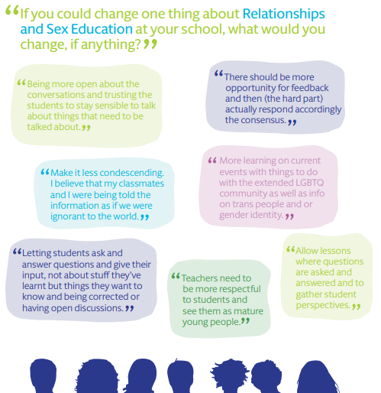
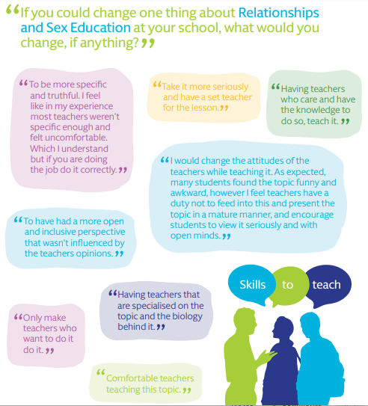
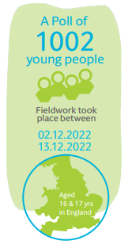
What young people said would help…
Notes:
Proper lesson time
More open discussions
LGBTQ+ discussions
How to tell if a relationship is healthy

Slide 4
RSE – how do we teach it?
RSE resources parent aware meeting in November every year
RSE letter to parents pre-Easter for Summer 1 term
KS2 girls meeting about toilet facilities
Publish resources on the website
Opt out via head teacher meeting /letter
Class rules in PSHE scrapbook signed by the class
Ask it basket
Confidentiality / safeguarding

Slide 5
Is RSE changing in schools?
RSE is still on the government agenda, however as the proposed changes in July 2024 are only in draft form the current curriculum remains. The key potential change was around specifying ages for RSE inputs rather than the current guidance:
The Relationships Education, RSE, and Health Education (England) Regulations 2019 have made Relationships Education compulsory in all primary schools. Sex education is not compulsory in primary schools.
It is important that the transition phase before moving to secondary school supports pupils’ ongoing emotional and physical development effectively. The Department continues to recommend therefore that all primary schools should have a sex education programme tailored to the age and the physical and emotional maturity of the pupils.
There are elements of sex education that are covered under the health and science curriculum.

Slide 6
RSE helping to prevent sexual abuse
New DofE guidance (Sept 24) in response to Ofsted’s report on sexual abuse in schools in 2021. Key guidance:
RSE is most effective when begun early
Supports young people to build and maintain positive, healthy relationships
Young peoples voices need to be at the centre of curriculum design (pupil voice on curriculum content Summer 2025)
Curriculum should build on previous lessons
Be inclusive particularly for LGBTQ and SEND
A consistent whole school approach
Lessons about consent should focus on actively seeking consent, this should be practised in daily school interactions. Children should understand that consent can be denied and constantly renegotiated
Teaching of consent should be subsequent to exploring and challenging gender stereotypes

Slide 7
BERT award
Building Effective Relationships Together run and assessed by Derbyshire services for schools.
Recognise the positive work done in school
Audit our curriculum provision
Seeks pupil and parent / carers views

