Slide 1
Year 3 curriculum workshop 2023
Please make sure you have signed the register.

Slide 2
Year 3 team
Miss Lester
Miss Martin
Mrs Brace
Mrs Mailer

Slide 3
Aim of today’s session:
To provide parents with:
Safeguarding, e-safety, allergy awareness, RE & SIAMs
General Class information
An overview of the curriculum content for Year 3
How you can help at home.

Slide 4









Class names- Composers
Hans Zimmer

Slide 5


Slide 6
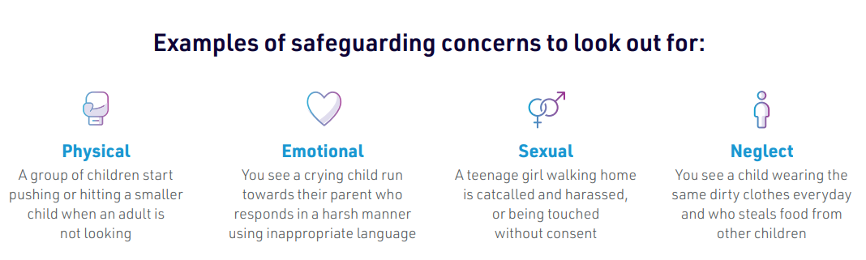
We have a statutory duty to safeguard pupils. This will mean our Designated Safeguarding Leads may have to have some difficult conversations sometimes.

Slide 7
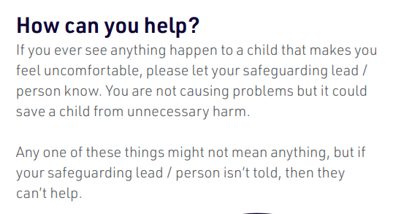
You can email safeguarding@coton-in-the-elms.derbyshire.sch.uk

Slide 8

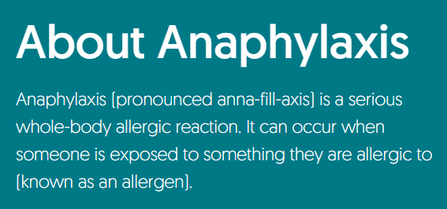
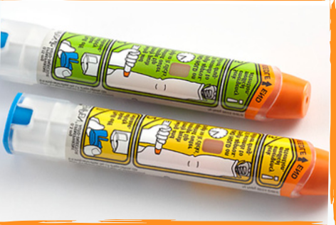
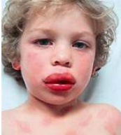
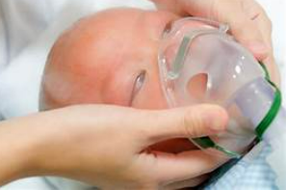
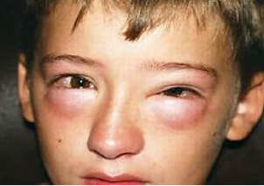
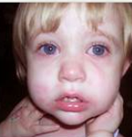
All staff are trained in recognising signs and symptoms. They also use a ‘dummy’ Epipen to practise what it is like to administer the adrenalin
We have 2 pupils currently who have allergies to nuts or egg. We politely ask for you to refrain from bringing in products that contain these allergens.
Every school class is likely to have at least one pupil with allergies.
The most serious allergic reaction (anaphylaxis) usually begins within minutes and is potentially life-threatening. Unfortunately, there have been cases of fatal anaphylaxis happening when a child is at school. Lessons learnt from these tragic cases emphasise the need for all school staff to be able to recognise the signs of an allergic reaction and have the confidence to manage this.

Slide 9

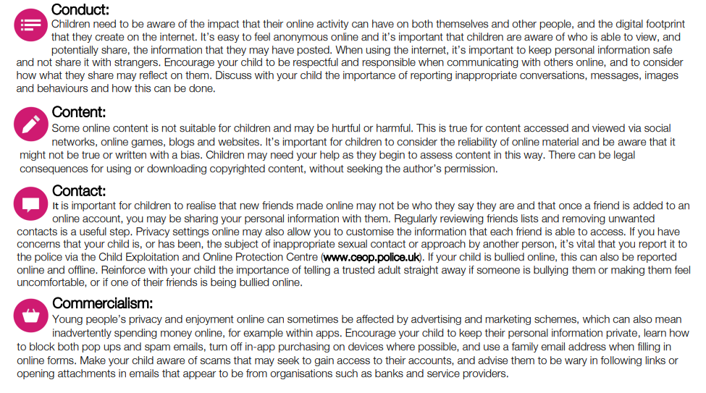
Parents: Supporting Young People Online (Leaflets) | Childnet
Notes:
The 4 ‘cs’ are the key aspects of staying safe online. Handout in your packs for additional information.

Slide 10

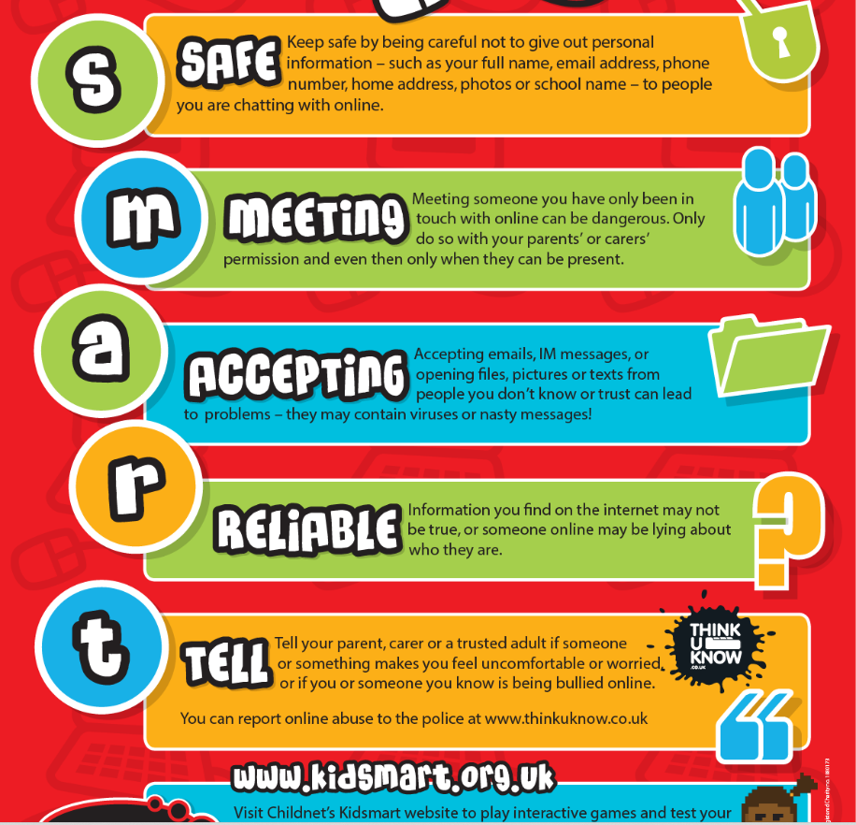
At Coton- in-the-Elms we teach children to be SMART online.

Slide 11
Personal Information
We always teach the children to never post any personal information anywhere online.
If they want to play a game that needs a username online, try to make sure they use a made-up name e.g. Captainfantastic326.
If their photo appears on the school website or around school, it will never be displayed with their full name.

Slide 12

YouTube
YouTube DO NOT censor their adverts –adverts or video comments may not be appropriate for your child.
When searching, your computer/tablet history will affect their search results.
This may result in inappropriate adverts appearing.
Be aware of what you search for on shared devices.
Create child friendly accounts for YouTube/Google for your children to use.

Slide 13



What can you do?
Talk to your child about their life online
Make sure your child knows they can always come to you for help and they won’t be blamed
Don’t threaten to ban technology
Practical steps you can take
Create a family agreement and regularly review
Primary aged children should only be live streaming and gaming in public rooms
Use parental controls
Ensure that explicit websites are blocked at source through your service provider e.g. Virgin Media, Talktalk
Report any concerns to local police, CEOP or the NSPCC
Notes:
What can you do? There are a lot of practical things you can do to support your child to stay safe online.
Talk to your child about their life online – When opening the conversation with your child start with positives, finding out as much as you can about what your child does online and what it means to them. Have ongoing conversations with your child about who they are talking to online. Questions about whether they know them in real life and what they share are vital to support your child to be safer online. Be non-judgemental and supportive in these conversations.
Make sure your child knows where to go for support - Help your child to identify adults that are there to help them. Children can sometimes feel they are to blame if something goes wrong online. Remind your child that they can always speak to an you or another adult they trust if they are worried, no matter what may have happened.
Don’t threaten to ban technology – It can help to suggest taking a break from an app for a period of time. This can help children learn from what happened, rather than banning them from the internet all together. Technology can provide sources of support to children and it is important not to ban them from this, which could lead to them taking greater risks by accessing tech somewhere else.
Practical steps
Create a family agreement - Before giving your child a device establish boundaries and rules. This is much easier to do before a device is given rather than after. Parents should research and review the apps/tech they are allowing their child to use, and set clear rules of use at the start and reiterate and review as the child uses it.
Use devices in public spaces - We understand that you can’t always be there with them, although if your child is primary school aged they should not access the internet unsupervised in private spaces, such as alone in a bedroom or bathroom. As young people develop, they often seek more privacy and autonomy in both their online and offline world but it’s important to consider whether your child is developmentally ready to be left unsupervised using devices. Young children do not have reasoning skills to keep themselves safe independently, if they are faced with experienced offenders who know how to manipulate and overpower children.
Parental controls – For detailed guidance on all the different types of parental controls, you can use an online tool from Internet Matters . This gives you the chance to set up a personalised list of the controls used in your home on all your different devices. There is also advice on how to use all the various controls, with videos and step-by-step instructions.
Report any concerns – if you have any concerns about online sexual abuse, report these immediately to local police, NCA-CEOP or the NSPCC.

Slide 14
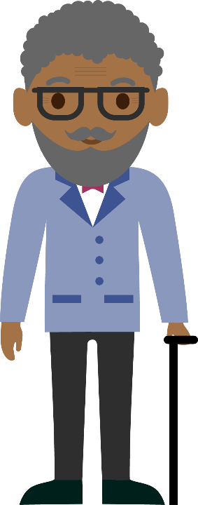


Talk to your child
Find a good time and place
Think about how you are going to introduce the subject
Explain any worries you may have
Where do they go online?
What do they like?
What don’t they like?
Make sure they know they can come to you
Listen. Don’t judge. Learn…
Notes:
Talk to your child
The best way you can protect your child is to establish a positive relationship with them around their life online. Talk to them – not just once, but have ongoing conversations as part of your family life.
Find a good time and place. Pick an opportunity when you know you’re not going to be interrupted and you are both going to feel comfortable and have enough time – without turning it into one of those ‘special talks’ moments.
Think about how you are going to introduce the subject. You could mention a recent story that they might have heard about or just explain why you would like to talk to them about something.
Explain to them any worries you have. Your child might think that you are getting worried for no good reason, but if you explain why something is troubling you they will understand why you want to talk to them. Tell them if it is something you have read about or seen their friends doing.
Listen. Don’t judge. Learn. Find out more about what they encounter online; what they are doing, where they go, what they like and don’t like. Parental engagement in the positive aspect of being online and not just the risky things will help your child to talk more openly about their internet use, including anything that worries them.
The most difficult conversations can be made easier if your child understands that you care about them and whatever the outcome you will love them just as much. One of the biggest barriers to young people seeking help if something goes wrong online is the fear of being blamed, getting into trouble, and suffering repercussions (such as tech being taken away). Make sure your child knows that they can come to you for help if they are ever worried and that they won’t get into trouble. Young people who are banned from going online, or who feel that what they are doing is wrong, are less likely to ask for help and that makes them less safe.
This is not on the slide but an important point to raise. Parental controls - Controls are an important first step to helping to protect your child online, but they are not a single solution to staying safe; talking to your children and encouraging responsible behaviour is critical. For detailed guidance on all the different types of control, you can use this online tool from Internet Matters. This gives you the chance to set up a personalised list of the controls used in your home on all your different devices. There is also advice on how to use all the various controls, with videos and step-by-step instructions.

Slide 15
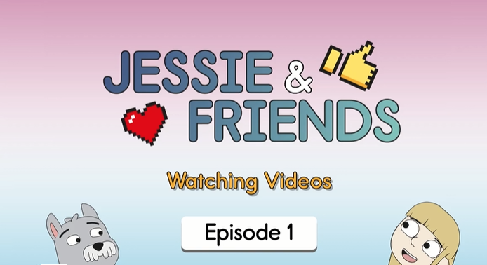
RESOURCES FOR PRIMARY AGED CHILDREN
4-7s: Watching Videos
https://www.thinkuknow.co.uk/4_7/4-5/videos/
Notes:
Insert YouTube video to slide – Jessie and Friends Parents video [Accessible from March 2019]
Non-subtitled version - https://youtu.be/Z8i7vnXQdvw
Subtitled version -
Insert video file to slide – Play Like Share Parents and Carers Trailer
Jessie & Friends – due for release March 2019
Jessie & Friends is a Thinkuknow education package for children aged 4-7 years. Jessie & Friends aims to give children the knowledge, skills and confidence they need to help them stay safe from sexual abuse, exploitation and other risks they may encounter online.
The animations and activities provide children with the opportunity to explore ideas like trust, false identity online, consent, and develop their confidence to ask an adult they trust for help if something online makes them feel uncomfortable.
Jessie & Friends does not depict any scenario involving an adult sexual offender and instead encourages children to focus on behaviours, not motivations which helps them identify and respond safely to strategies that sexual offenders typically use to groom children. It does so without raising confusing, frightening or age-inappropriate questions about why an adult might behave in this way towards a child.
Each animation has been specifically created for different age groups:
Episode 1 - Watching videos (4-5 years)
Episode 2 – Sharing pictures ( 5-6 years)
Episode 3 – Playing games (6-7 years)
Each episode ends in a catchy song, aimed to reinforce the films safety messages. More information for parents and carers can be found at www.thinkuknow.co.uk/parents/jessie-and-friends
Play Like Share
Play Like Share is one of the Thinkuknow resources for 8-10 year olds. It is a three episode animated series that follow the adventures of Alfie, Ellie and Sam as they form a band and enter their school’s Battle of the Bands contest, taking on the mean but ‘cool’ Popcorn Wizards as they go. The three friends learn that while the internet can help, they need to use it wisely and safely. The films teach children how to spot the early signs of manipulative, pressurising and threatening behaviour by people they might meet online, and develops their confidence to respond safely and get help.
You can watch Play Like Share with your child and use this to start a conversation about the internet and staying safe. All three episodes can be found on the Thinkuknow website for 8-10 year olds. You can download the Play Like Share Parents and Carers Factsheet for ideas and support on how to watch and discuss Play Like Share with your child, at Thinkuknow.co.uk/parents [If appropriate, offer Factsheet as a take-home handout].
Band Runner
Also on the Thinkuknow website for 8-10 year olds is a fun interactive game called Band Runner that helps 8-10 year olds learn how to stay safe from risks they might encounter online. Children can chose to play the game as the Play Like Share characters Ellie or Sam, and the game tasks them with helping Alfie to make safe choices online. Players run through school and collect stars for points, whilst using their guitars to eliminate all obstacles in their path as they try and make it to their next gig. If players miss a jump or take a tumble they then need to help Alfie solve an online safety dilemma to be able to continue play.

Slide 16


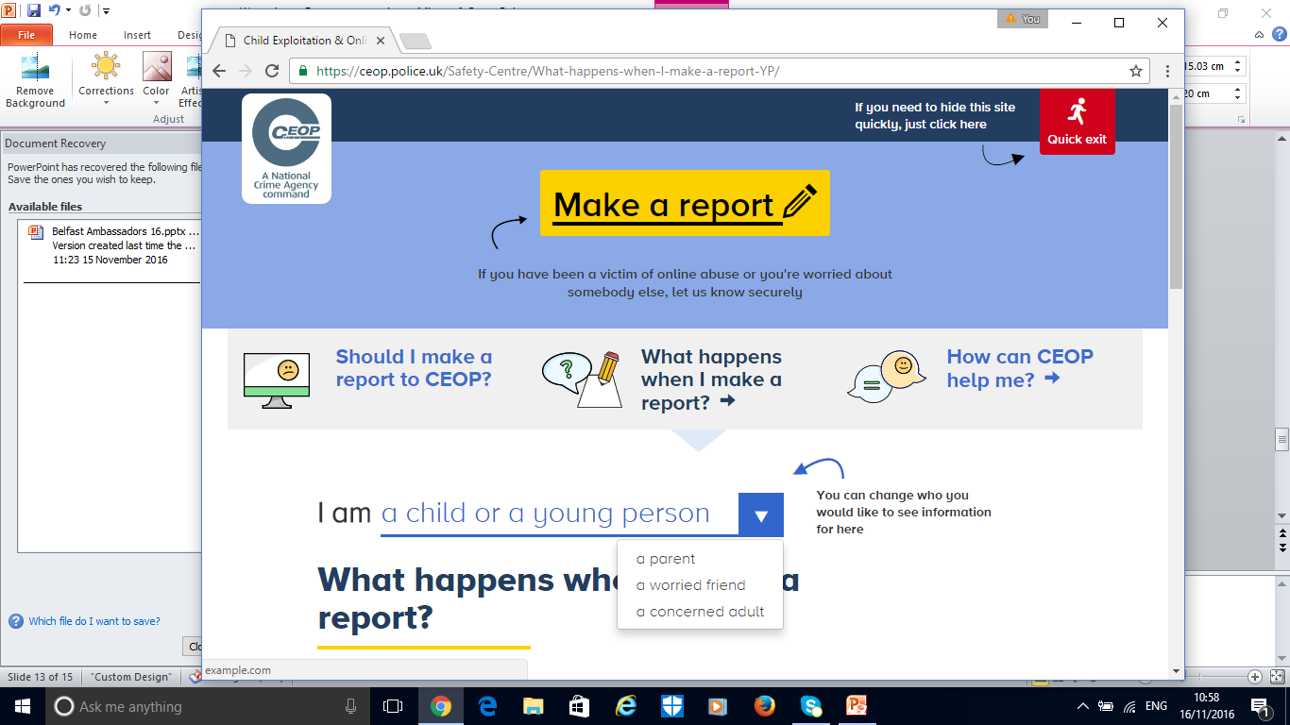
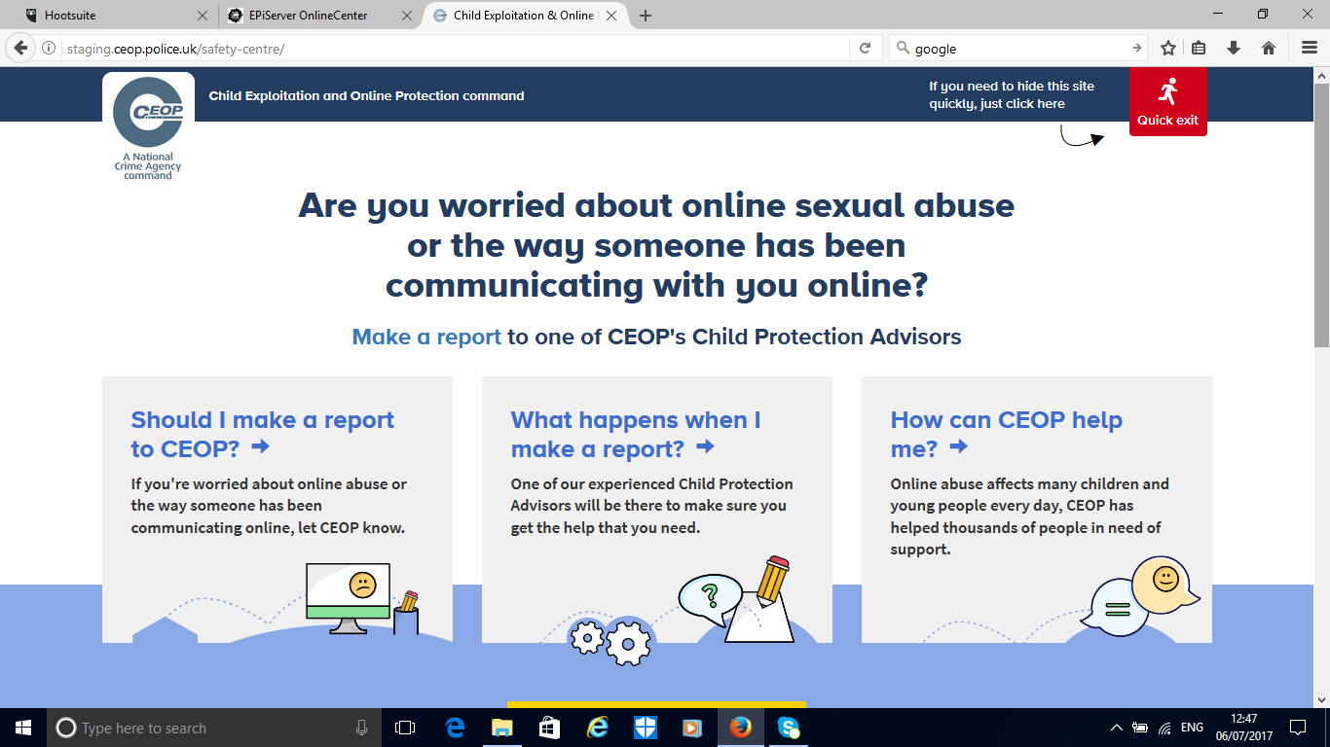
CEOP http://www.ceop.police.uk
Think You Know www.thinkuknow.co.uk
Childnet http://www.childnet.com
Notes:
Note to presenter: Before delivering this section, familiarise yourself with NCA-CEOP’s website and advice pages by visiting www.ceop.police.uk.The website has information on:
When to report to NCA-CEOP
What happens when a report is made to NCA-CEOP
How NCA-CEOP can help
The NCA-CEOP website is known as the ‘safety centre’ as it hosts an online reporting tool, made specifically for children and young people in order for them to report concerns relating to online sexual abuse and exploitation directly to NCA-CEOP. Parents and carers can also report to NCA-CEOP if they are worried about a child or young person in their care. The buttons on the right hand side of the screen link to the safety centre. The Click CEOP button can be embedded on external websites, such as a school’s website (if you have the button on your organisations website tell audience where this can be found) and the ‘worried about something’ button is hosted on the Thinkuknow 8-10 year old website.
NCA-CEOP takes all reports seriously. The reporting form is designed to be as accessible as possible by children, but it is highly recommend that young children of primary school age seek the support of an adult they trust to help them make a report.
It is not possible to report to NCA-CEOP anonymously. NCA-CEOP advise any urgent reports where a child is in immediate danger should be reported to the local police force where the child is located.
Cyberbullying should not be reported to NCA-CEOP as it falls outside their remit of CSAE. Children and young people should be directed to speak to an adult they trust, and/or referred to Childline, if they would like to speak to someone about how they are feeling.

Slide 17
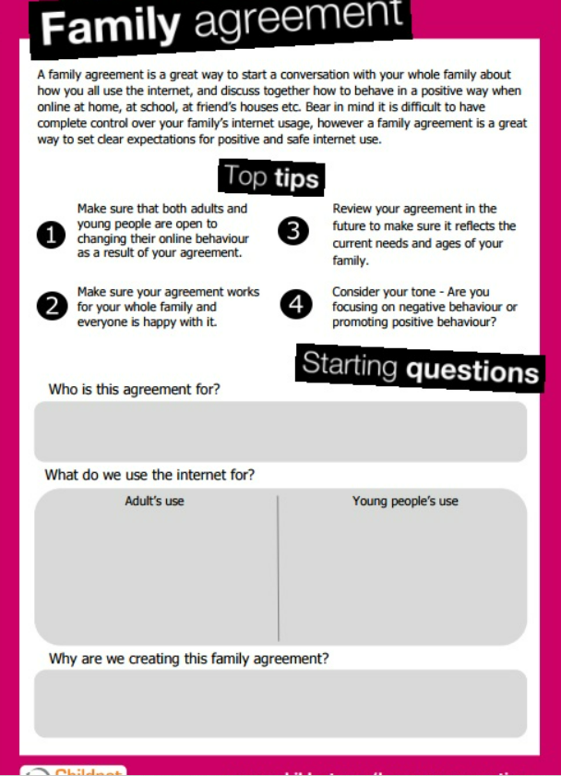
Parents: Supporting Young People Online (Leaflets) | Childnet
Notes:
This is one way of initiating a discussion and setting the expectation about using the computer and internet safely.

Slide 18
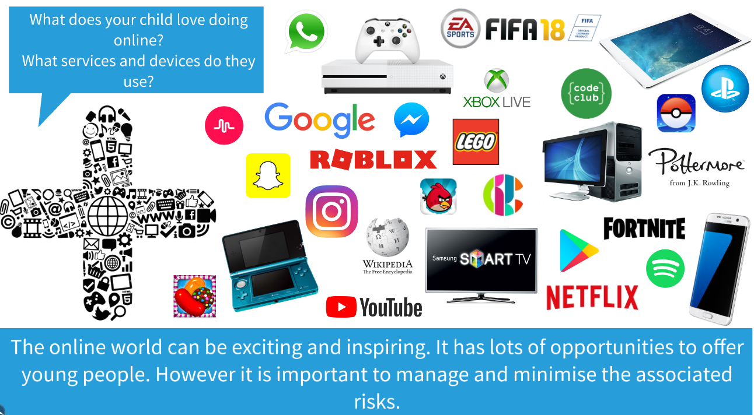
Look out for top tips and helpful information released with our monthly newsletter. You can also find a link to online safety information on the website in the safeguarding section.

Slide 19



RE and Statutory Inspection of Anglican and Methodist Schools (SIAMS)
As a Church of England School, our school values are underpinned by Biblical Scripture. Coton’s is: 2 Corinthians 13:11: Brothers and sisters, rejoice! Strive for full restoration, encourage one another, be of one mind, live in peace.
The dove you see in school symbolises PEACE. This is an acronym for Perseverance, Enjoyment, Awe and Wonder, Compassion and Excellence)
As with all maintained schools in England we:
teach Religious Education in line with the locally agreed syllabus
hold acts of collective worship every day
teach about world faiths
In addition, Church of England Schools provide:
education underpinned by Christian values
close links with the community
partnership with the local church

Slide 20

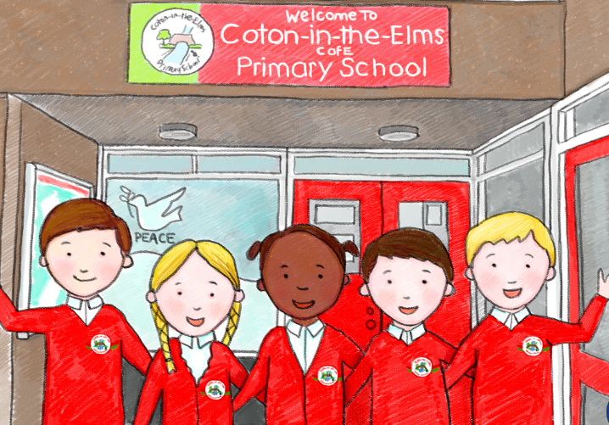
This year we will receive a Section 48 SIAMS inspection
Inspectors will judge the school by asking 3 key questions:
Who are we as a school? - factual questions about your school's context
What are we doing here? - mainly about the theological underpinning of our school's vision, governance structure, arrangements for religious education and collective worship, and partnerships
How, then, shall we live and learn together? - the main inspection questions looking for evidence of impact
In February 2017, the school received an OUTSTANDING judgement for SIAMS. The framework has now changed and the school will receive a judgement of

Slide 21

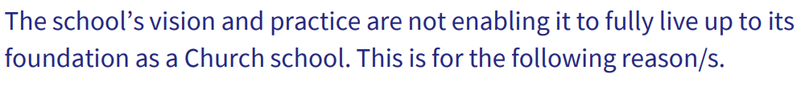

Judgements
Judgement 1
Judgement 2

Slide 22
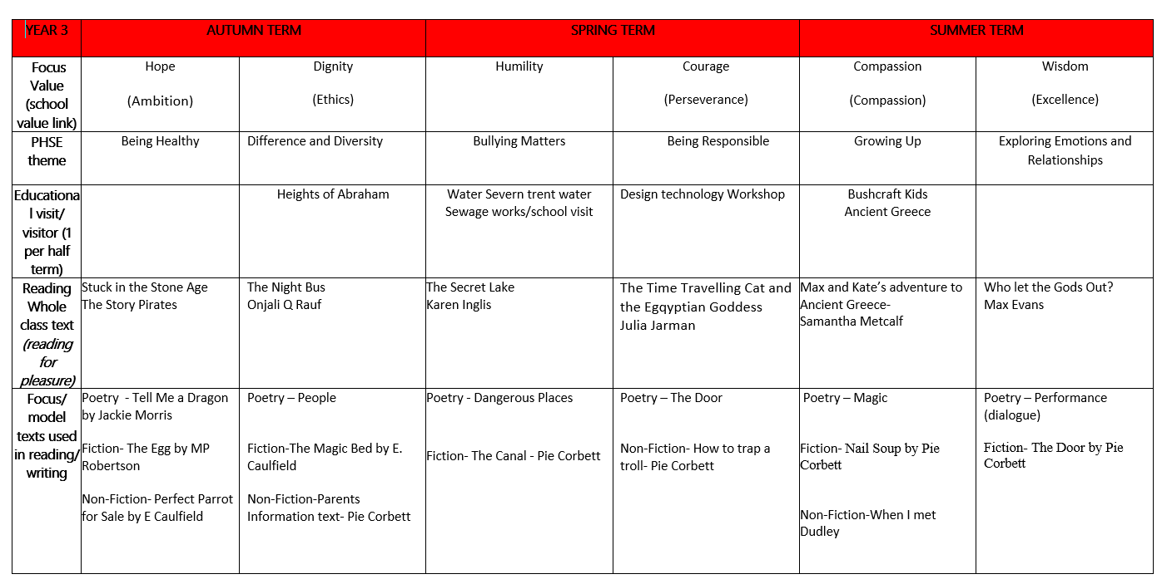
Curriculum map – on our website (subject to change!)

Slide 23
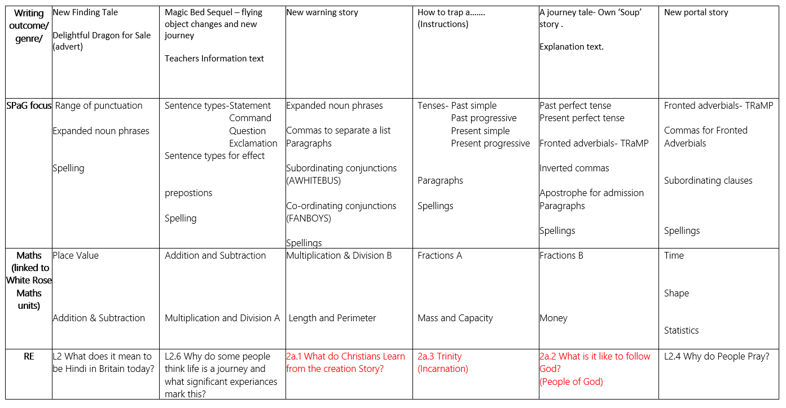

Slide 24
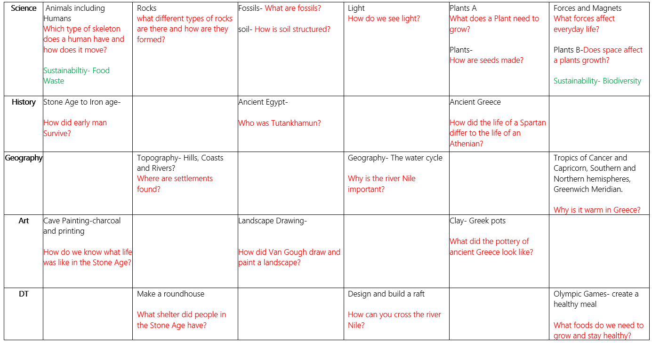

Slide 25
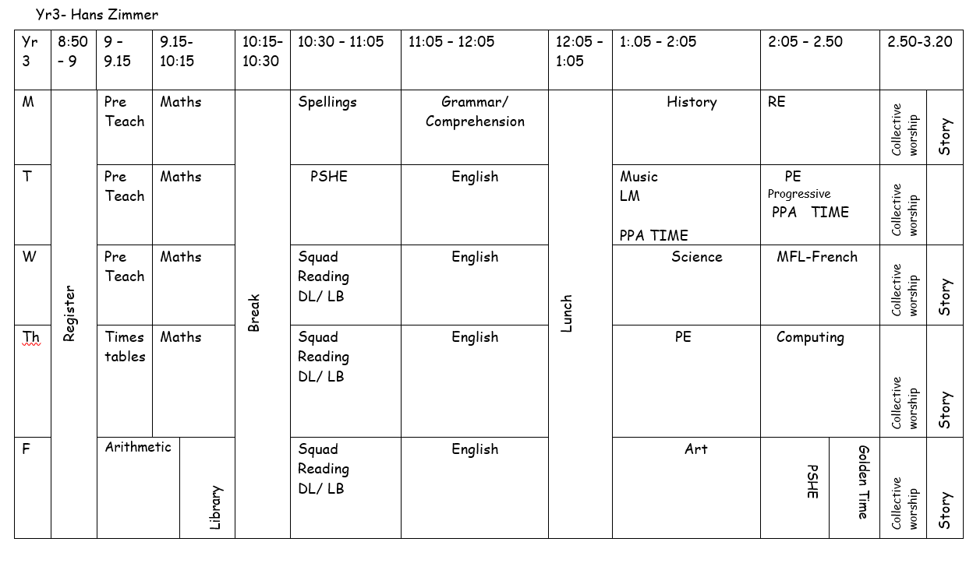

Slide 26

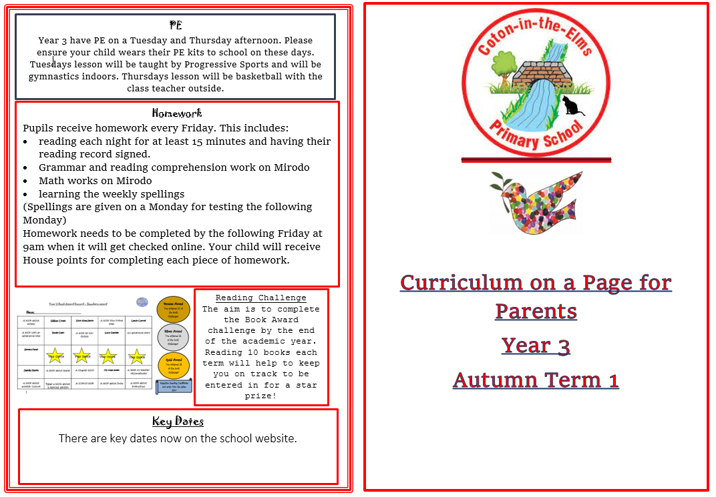
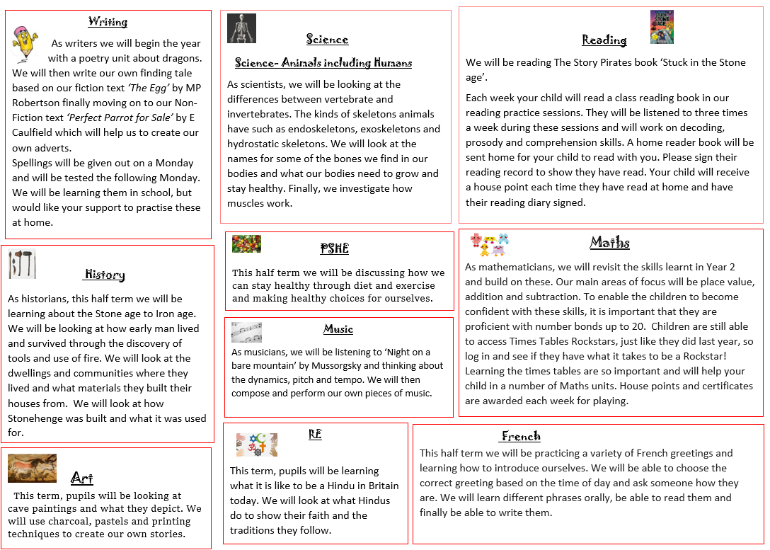
Curriculum Letters
Found on the school website
Different one for each half term

Slide 27

Science topics:
Animals including Humans
Rocks
Fossils and Soil
Light
Plants-what do they need to survive
Plants-pollination, seed dispersal
Forces and Magnets

Slide 28


Topic
Autumn term:- Stone age to the Bronze age
Spring term :- Ancient Egypt
Summer term: Ancient Greece

Slide 29

PE
Autumn 1 Autumn 2 Spring 1 Spring 2 Summer 1 Summer 2
Tuesday and Thursday afternoon
Tuesday afternoon with Progressive Sports
Thursday- Miss Lester
Children now come to school in the PE kit when it is a PE day.
Can each child have a set of pumps for indoor PE- these can be kept at school
(trainers for outdoor PE)

Slide 30
Planners
Primary method of communication
Homework acknowledgement of completion
Messages
Change of adult collecting
Reading record: please record any reading completed at home (House Points will be given in school)
Checked daily by staff
Supportive learning tool at the back – sentence tricks, conjunctions, number grid, times table square
Targets your child will be working on for Maths, English and Reading

Slide 31
Maths!

Slide 32


4 lessons a week- White Rose Maths
Arithmetic lesson once a week

Slide 33

Are we talking the same language?
Numeral
Number
Digit

Slide 34
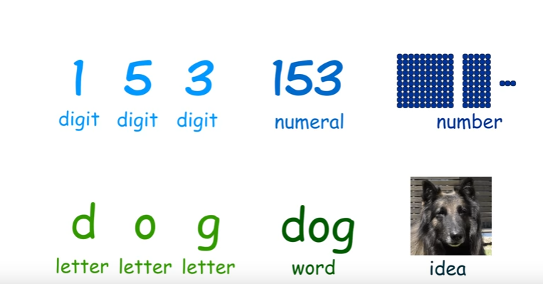

Slide 35

Process of learning
This happens in most lessons – all the way up to Year Six

Slide 36
Multiple representations
“If we do not use concrete manipulations, then we can not understand mathematics. If we only use concrete manipulations, then we are not doing mathematics.”
Gu (2015)
Notes:
Concrete manipulatives are essential learning tools, but if pupils use only concrete resources, then they will become mechanics of maths, rather than mathematicians. With this in mind, the final quote powerfully reinforces and summarises to your staff the importance of switching through the three different modes to develop and deepen understanding.

Slide 37
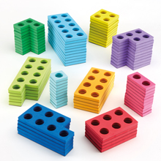


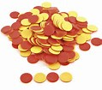
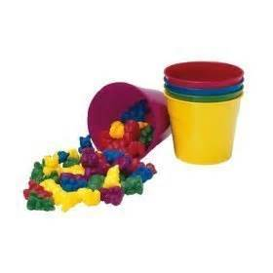

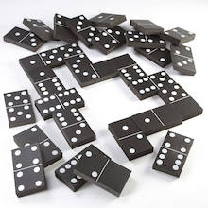

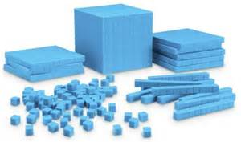
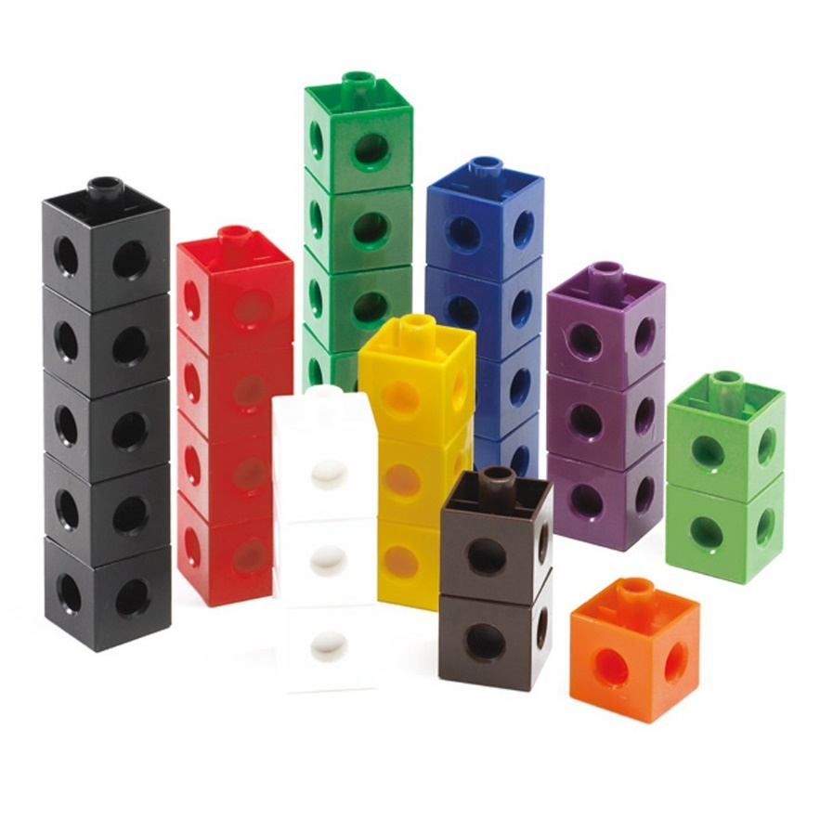

A range of resources
Notes:
Discuss the different resources displayed and explain that concrete options are endless. Concrete resources are simply practical items that pupils can hold and manipulate to help them explore abstract mathematical concepts and the relationships between them.
After slide 4, share the White Rose Maths Hub video, The importance of concrete. Give teachers time to discuss what they like and/or dislike about the video and explore the key messages.

Slide 38


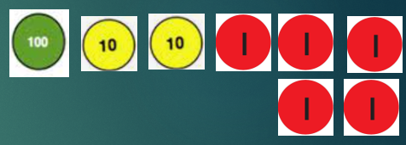

Using the equipment can you represent the number
125
Can you now add 23 to your original number

Slide 39



Year 3 | Week 1 | Day 1
3 $×$ 2
1) How many tens are there in 67?
2) How many minutes are there in 1 hour?
3) Write the time shown on the clock.
4) Add 12 and 27 together.

Slide 40
Year 3 | Week 1 | Day 1
3 $×$ 2
1) How many tens are there in 67?
2) How many minutes are there in 1 hour?
3) Write the time shown on the clock.
4) Add 12 and 27 together.
6 tens
60 minutes
8 o’clock
39

Slide 41
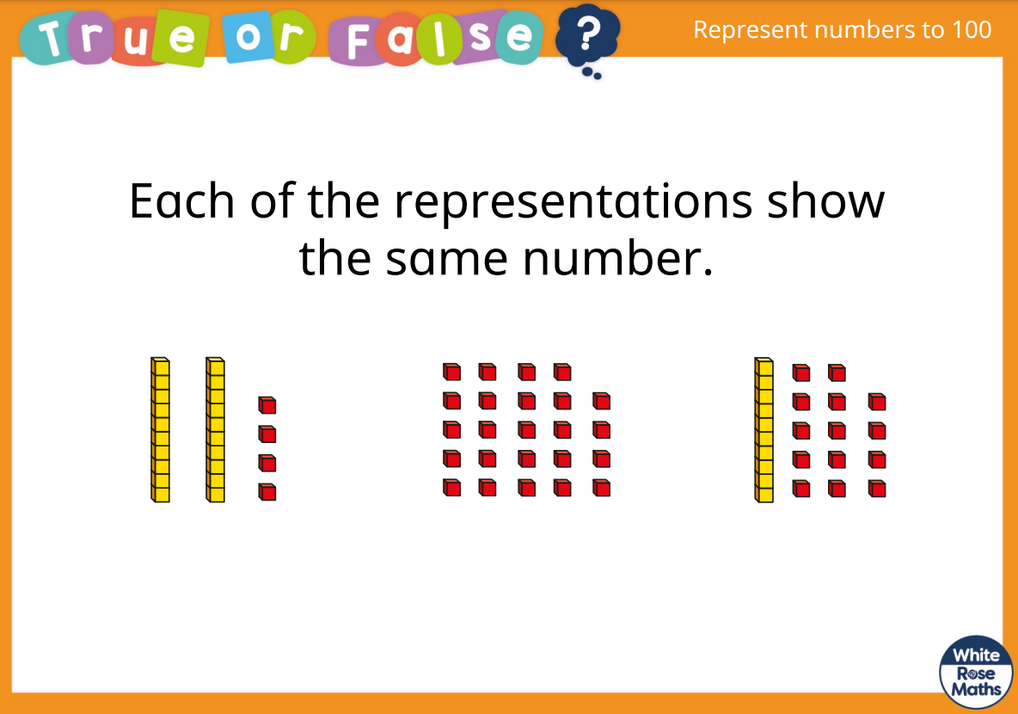

Slide 42
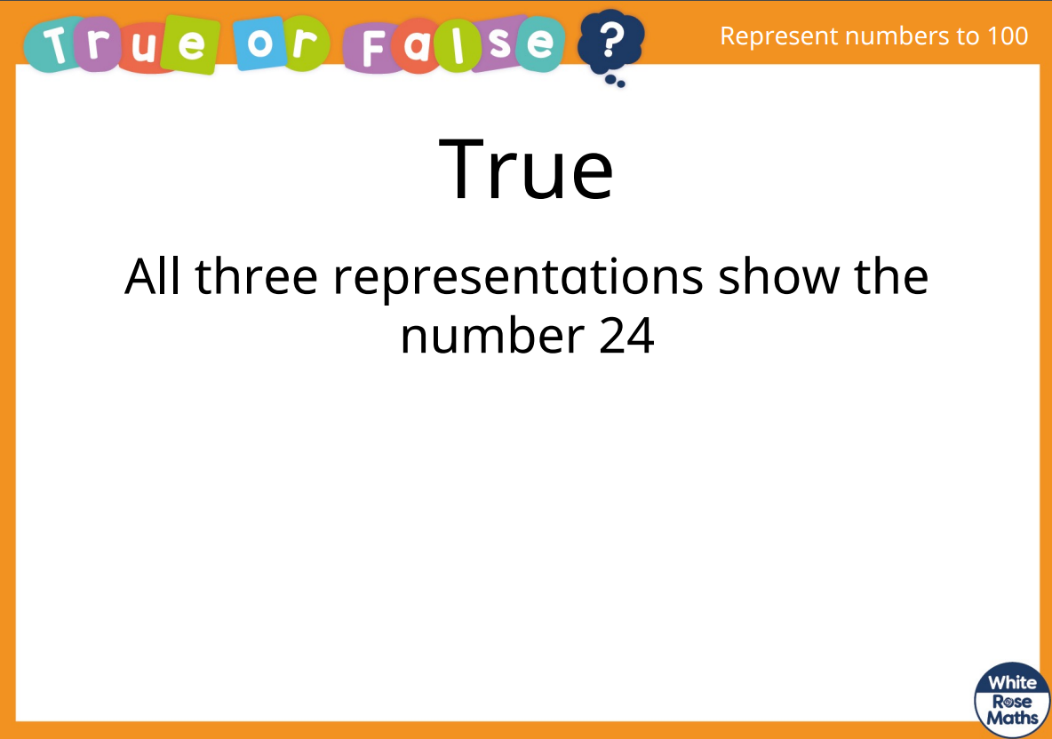

Slide 43

Times tables
The times tables we focus on in Year 3 are:- 3x 4x 8x
Times tables have been set for the
children and will build up over the year.
The questions are timed
Repeats same questions to improve speed and accuracy
House Points and certificates are awarded

Slide 44
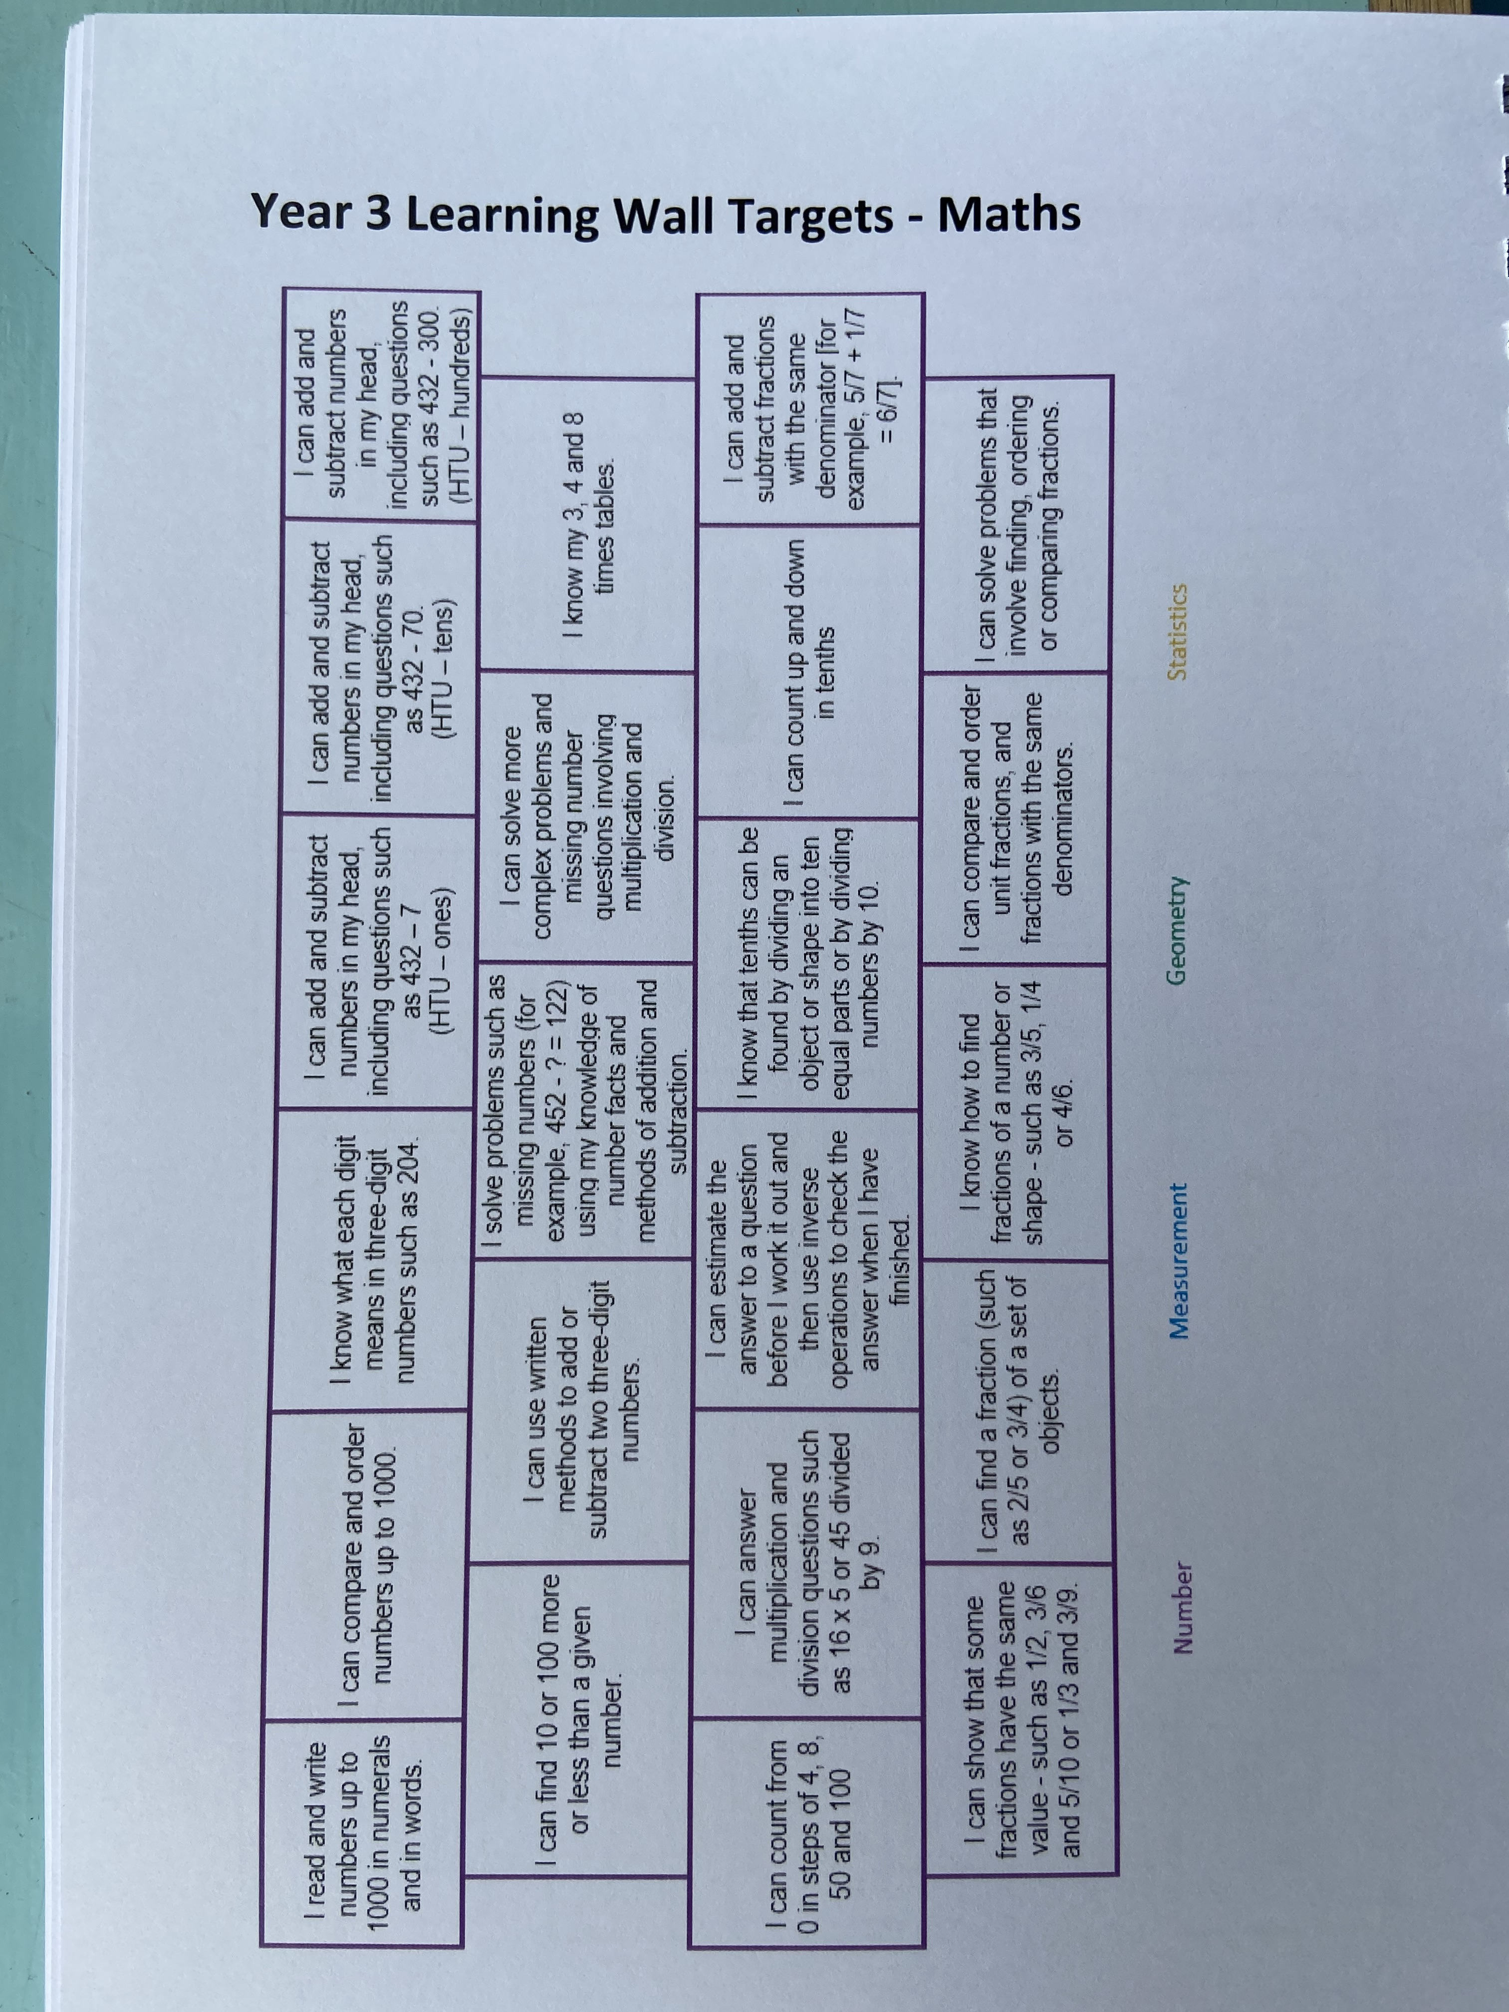
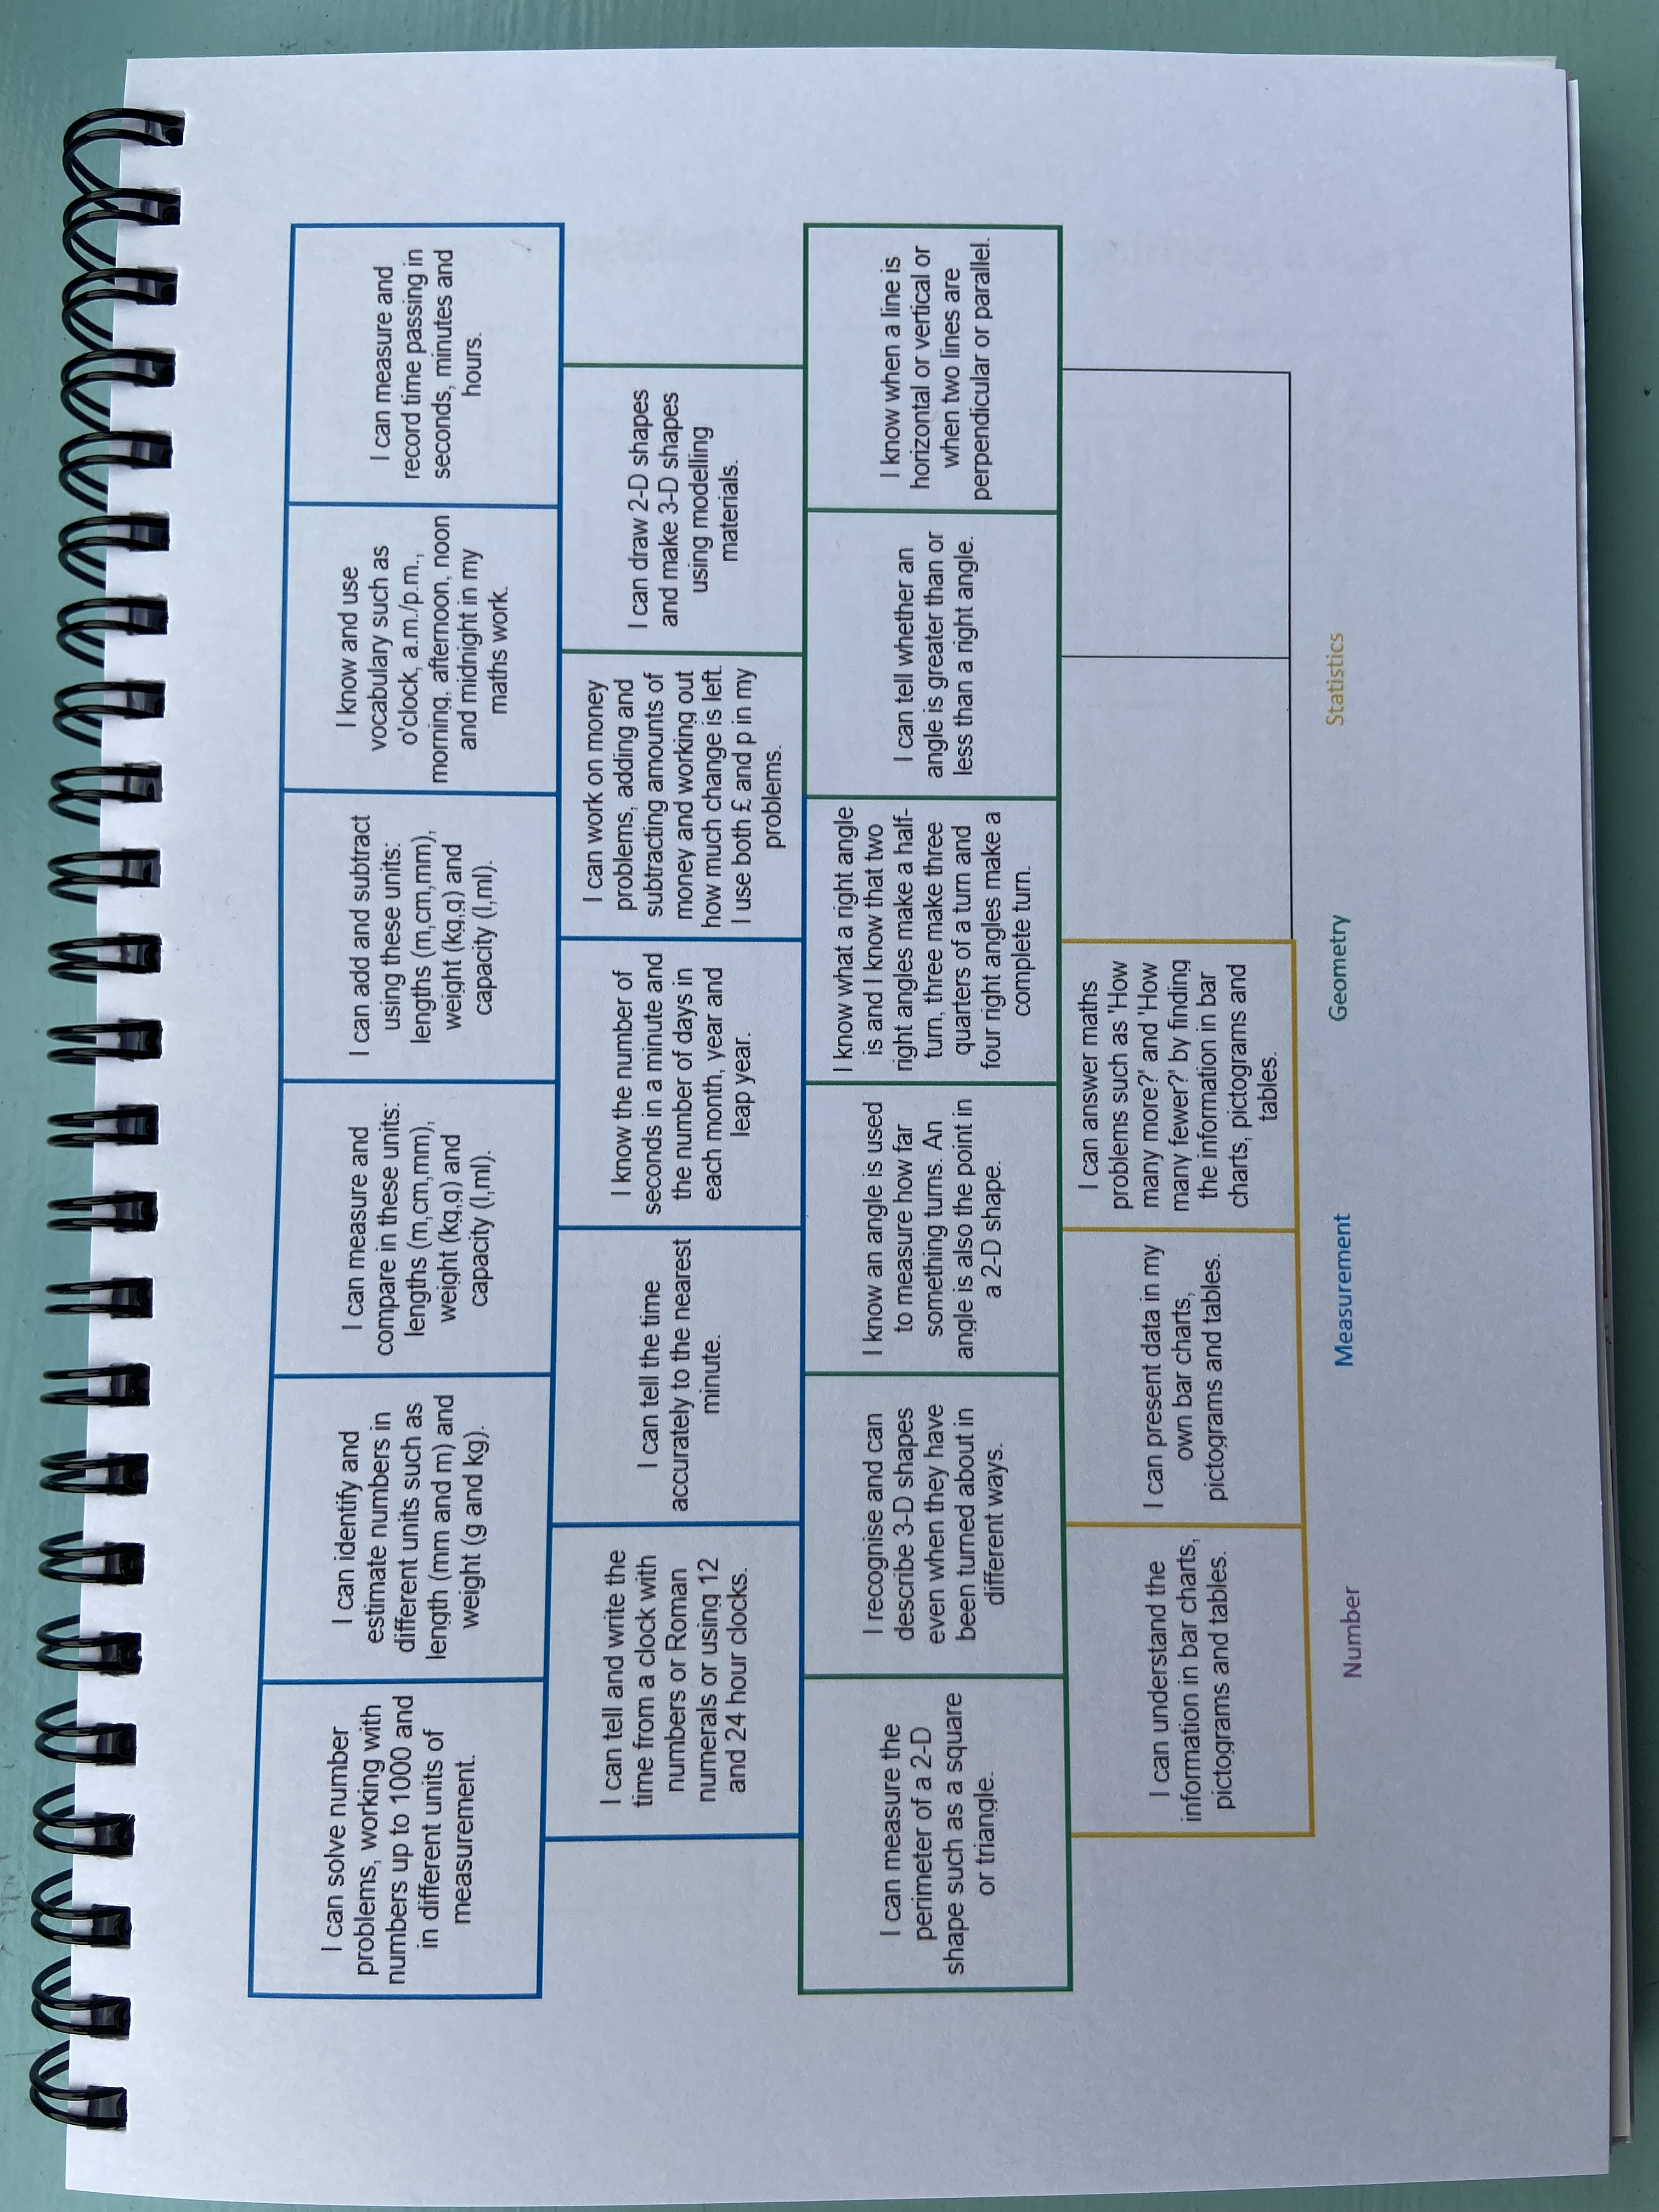
Maths targets

Slide 45
Spellings
Spellings are given out on a Monday and follow a particular spelling rule, they are then tested on a Monday morning.
(There are 100 Year 3-4 words to know by the end of Year 4)
Practiced three times over the week in spelling books at home.
We will have a spelling activity to practice spellings in class twice a week.
We also have dictation or handwriting once a week which use the spelling words.

Slide 46


Slide 47


We now follow Little Wandle program from EYFS.
In Year 3, children should now be able to read fluently so we start to teach whole class reading sessions, focussing on comprehension. We continue to utilise their reading approach of delivering 3 reading sessions per week
Day 1 – decoding and understanding word meanings (see Oracy booklet)
Day 2 – prosody (expression)
Day 3 – comprehension (understanding)
Notes:
Reading is a skill for life and should be something children enjoy.
Reading underpins writing.

Slide 48

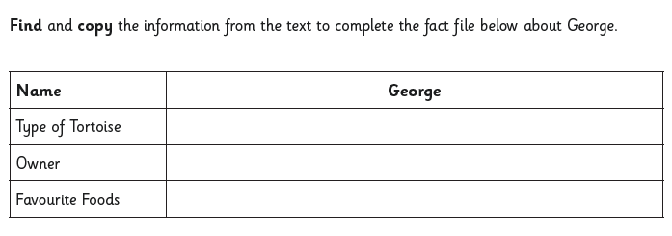
Example of tasks to give children to help them later access tests.
Look back at the text and find easy answers

Slide 49
Example of tasks to give children to help them later access tests.
Look back at the text and find easy answers
 | True | False
Wilhelm Grimm was born in 1786.
The bothers shared the same middle name.
Their favourite story teller when growing up was Mary Muller.
Their first book of fairy tales told seventy tales.
Their second book of fairy tales was published in 1814.
The original Grimm’s fairy tales was too violent for Victorian children.
Modern fairy tales are often less violent than Grimm’s original.
Wilhelm died five years before his brother Jacob.

Slide 50
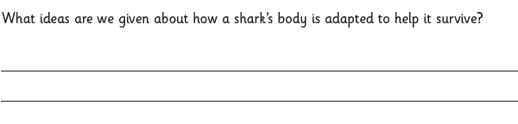
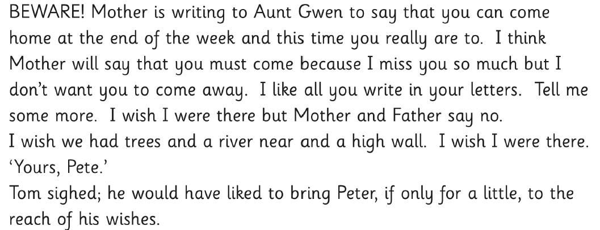
Example of tasks to give children to help them later access tests.
2c summarise main ideas from more than one paragraph
Underline the most important words in this piece of text:

Slide 51

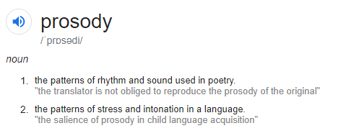
Prosody
Strategies for teaching prosody:
Model this effectively to children and allow them time to practise. Draw on how important punctuation and the way the text is printed on how we read the text.
Pre-tutor the tricky words (the strategy check part.)
Use MTYT approach for children to hear a good model and then to have a turn. Echo reading.
Children read the book using fluency, teacher listens to children read. Children re-read again if expression isn’t quite right.
Use of reading volunteer helpers.

Slide 52
Commas save lives
Let's eat Grandma!
Let's eat, Grandma!

Slide 53
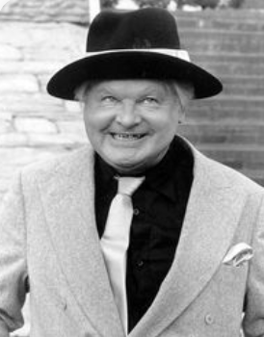
What's that in the road, a head?
vs
What's that in the road ahead?

Slide 54
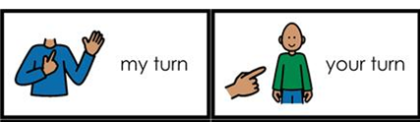
Echo reading
Use my turn, your turn (MTYT)
Great way to teach Prosody.

Slide 55
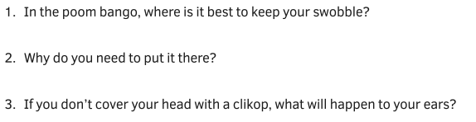
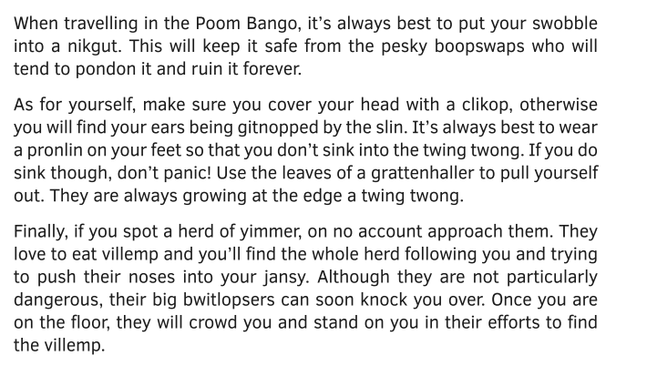
Why is comprehension important?

Slide 56





Promoting reading for pleasure
We go to the school Library on a Friday Morning

Slide 57
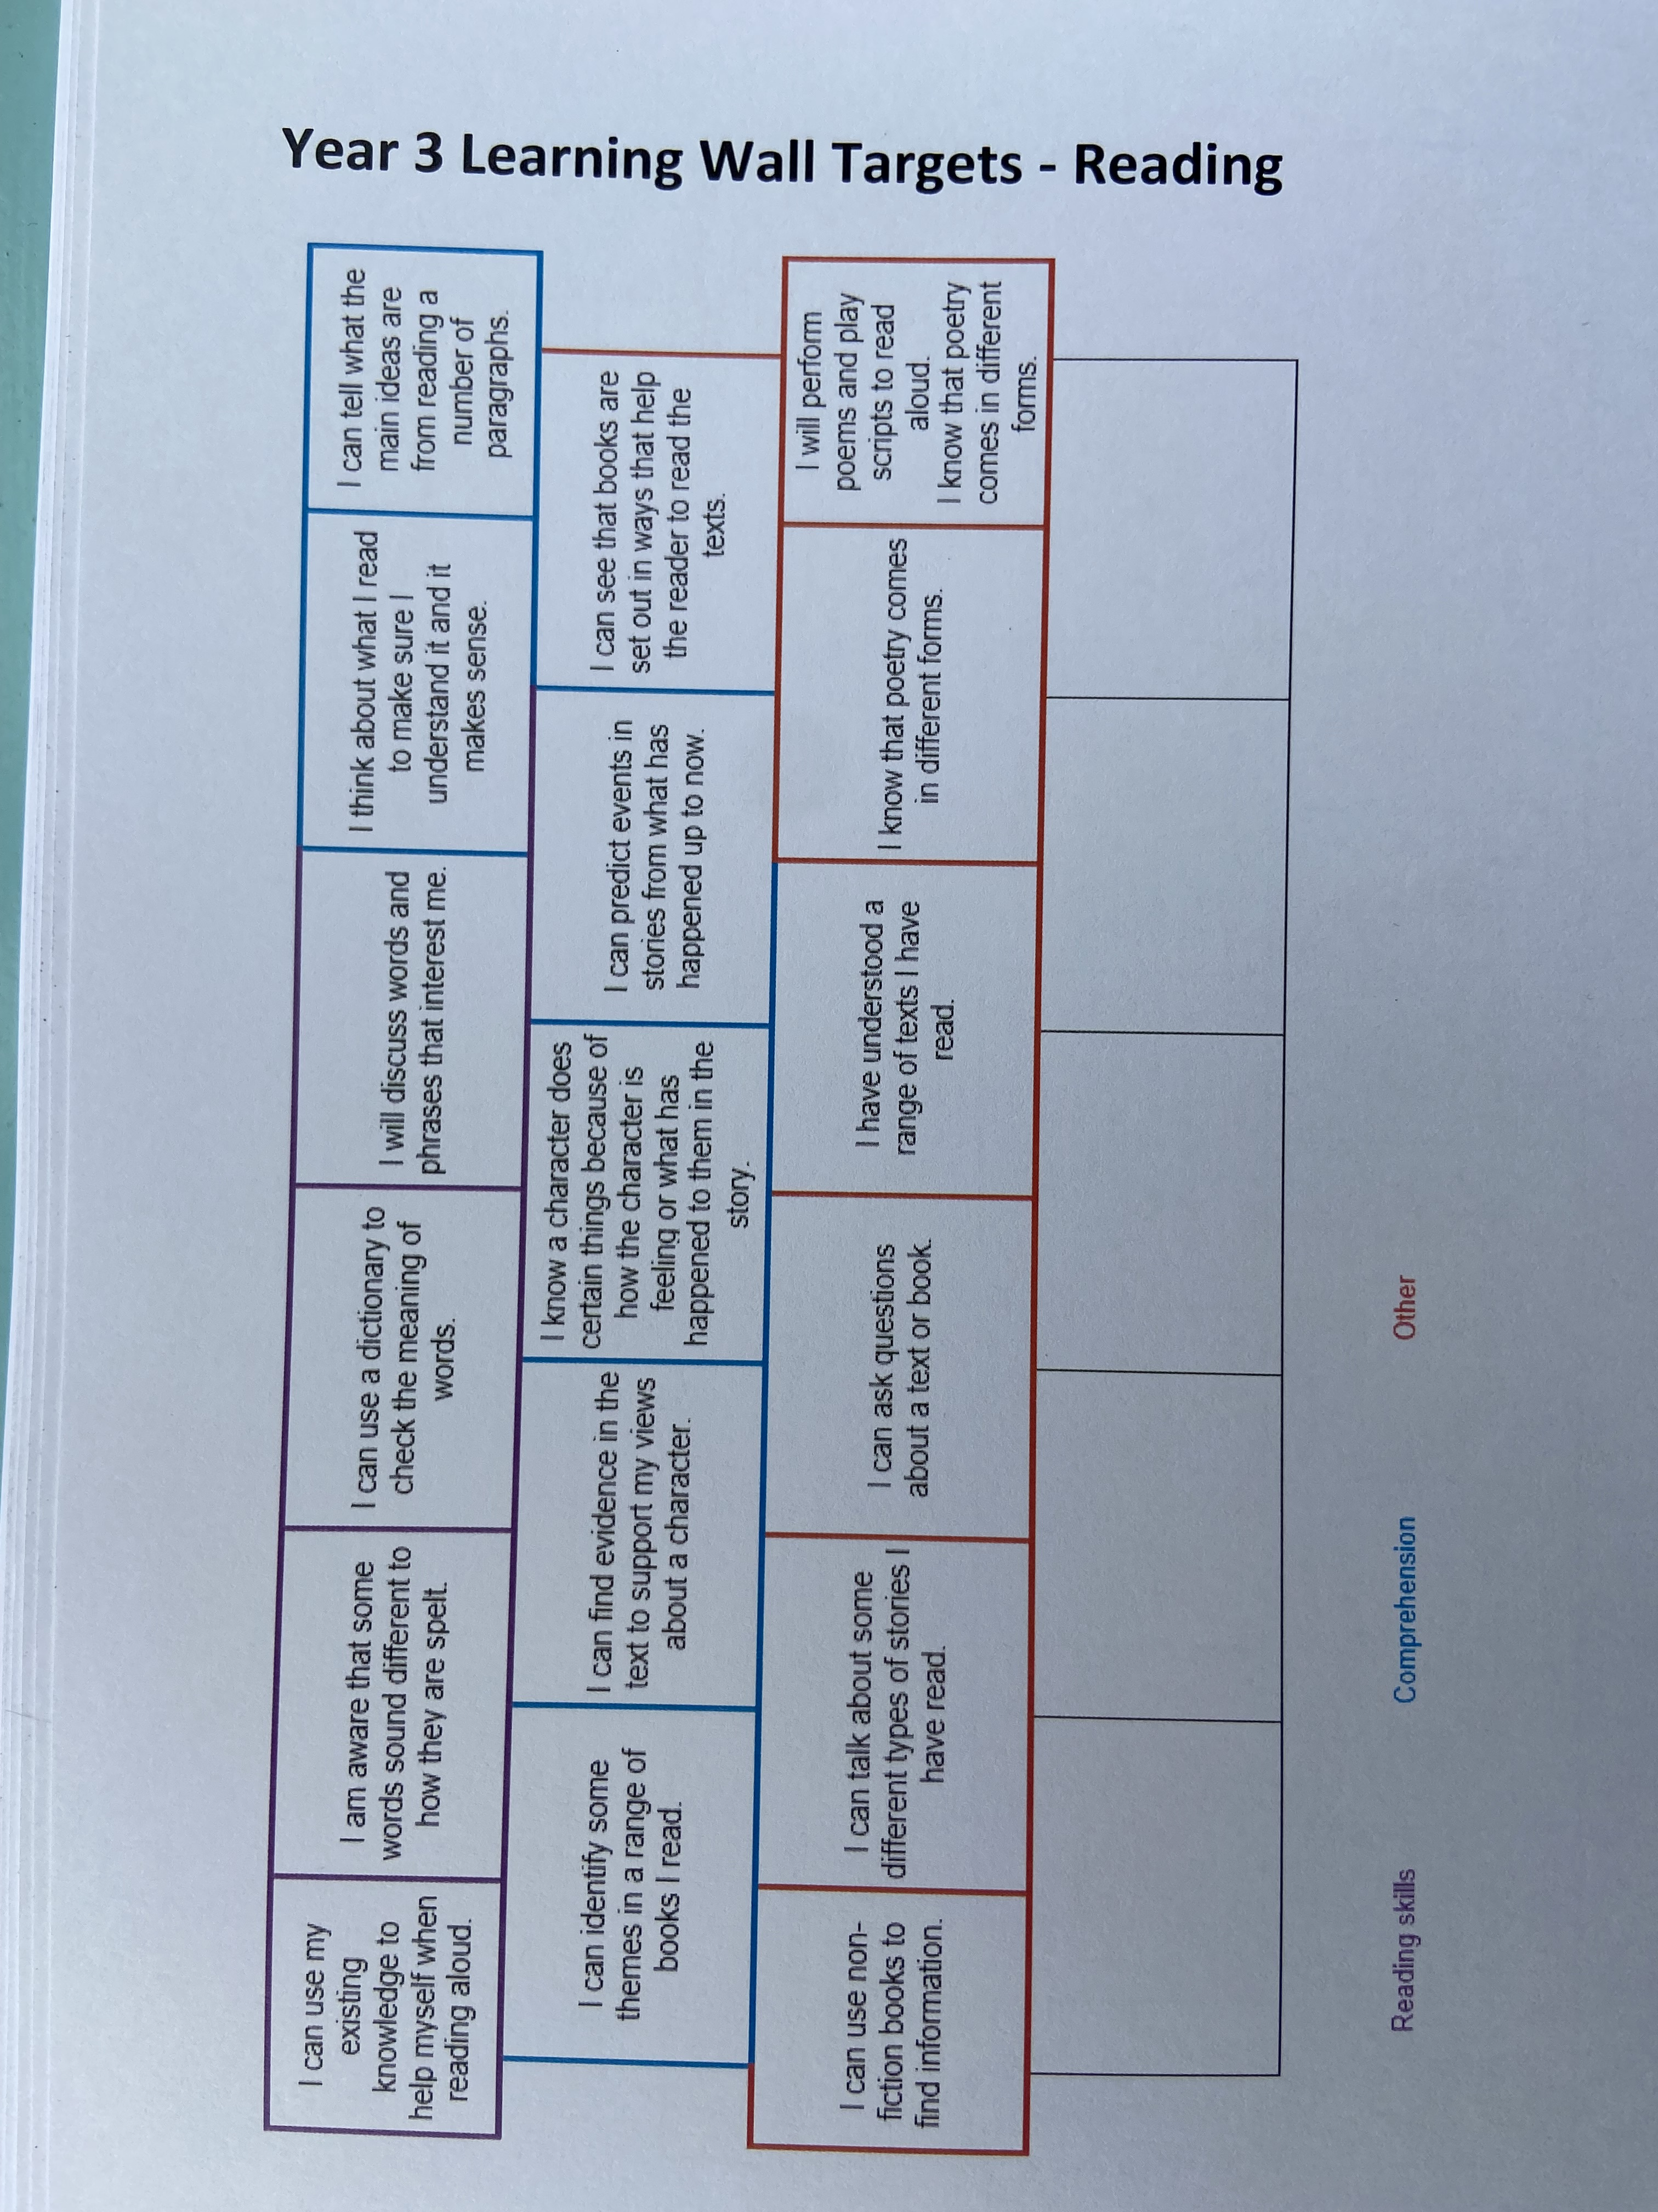
Reading targets

Slide 58


Writing

Slide 59

Each term we look at-
A piece of poetry
A fiction text – (different types of stories)
A non- fiction text- (advert, instructions, explanation)
We learn the text with actions
Look at the features of the text and focus on content
Plan our own text to include the focused content
We write our own text

Slide 60
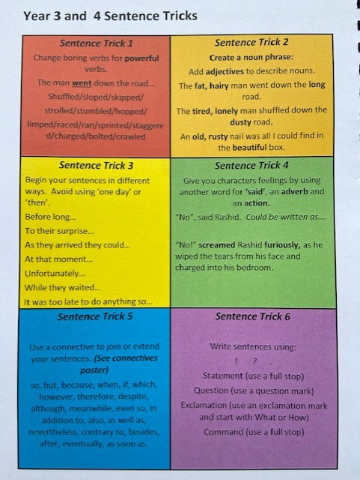
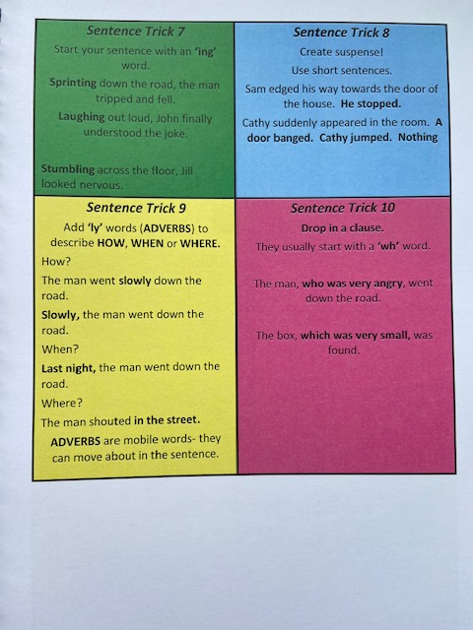
In writing we use the sentence tricks to help improve our ideas.

Slide 61
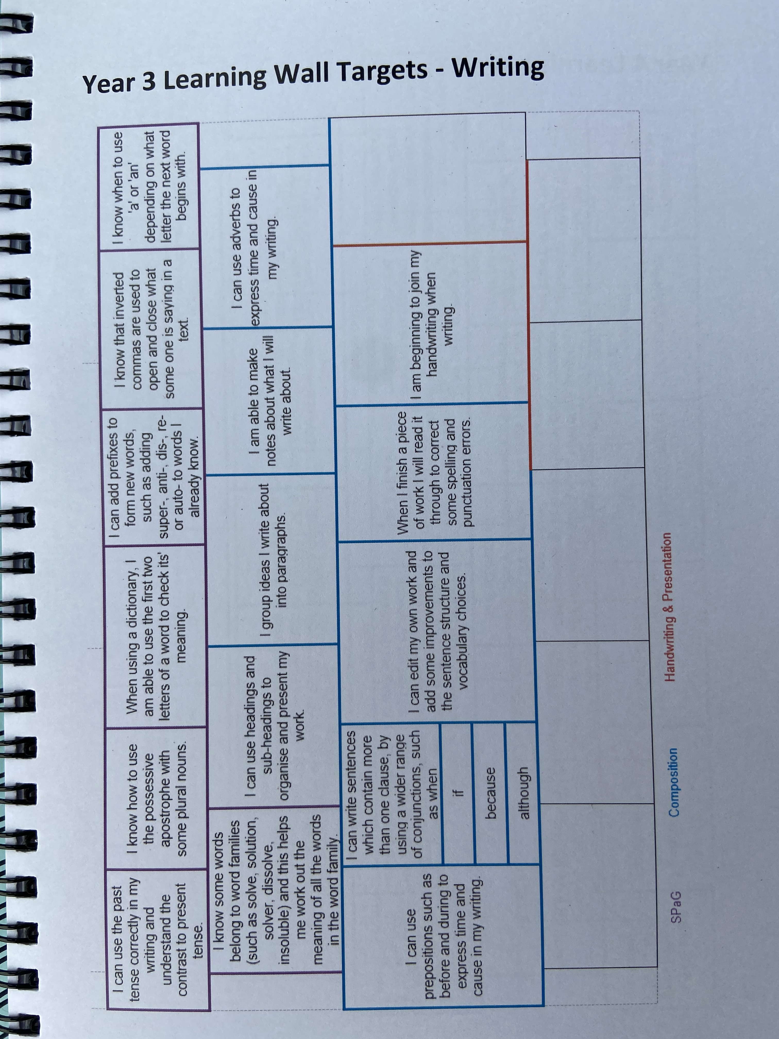
Writing targets

Slide 62
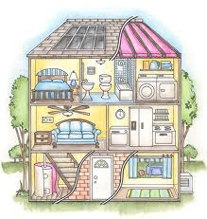
Helping at home
Times tables
(2, 3, 4, 5, 8, 10,)
Telling the time
Reading regularly (written in planner)
Learning spellings

Slide 63
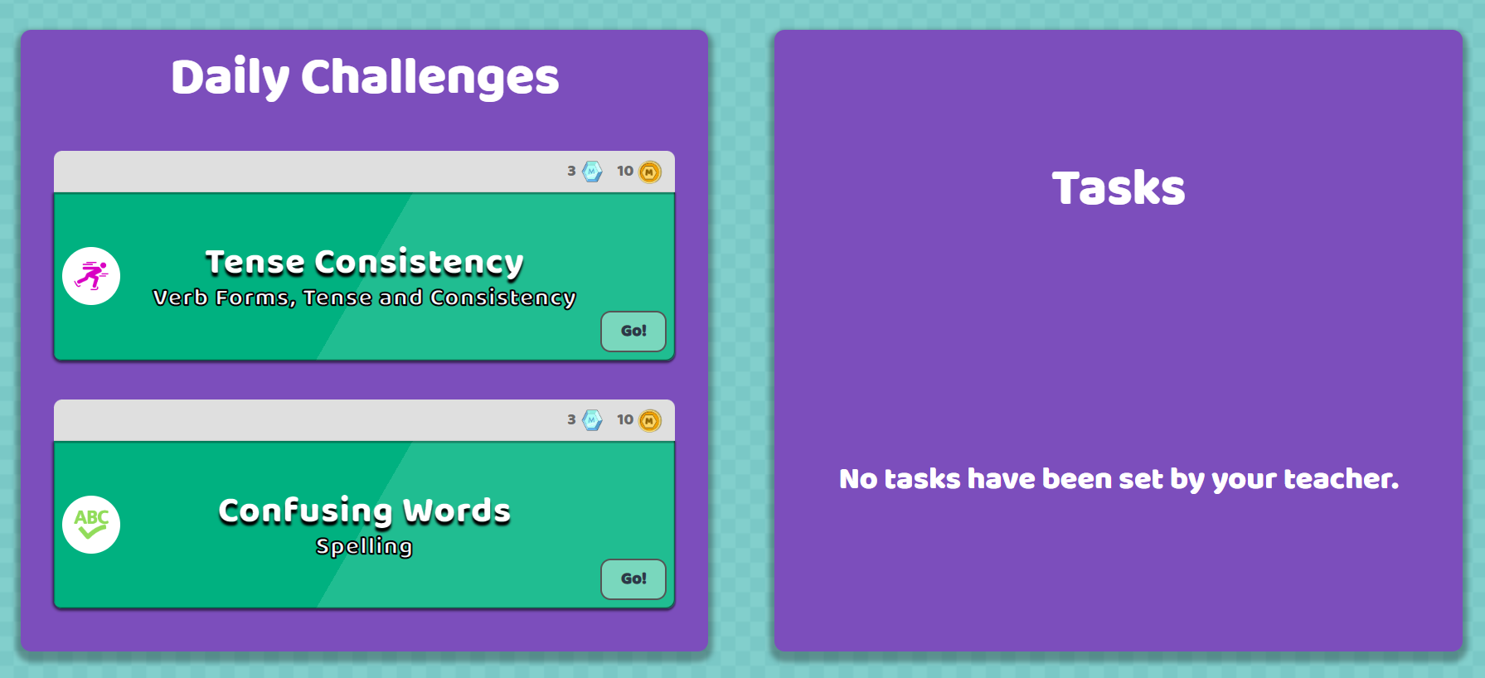

Homework- Mirodo
1 English grammar
1 Reading
1 Maths
Homework club on a Tuesday lunchtime

Slide 64

Are there any questions?
Please make sure you have a transition booklet and have completed the evaluation form.
Thank you for attending today.

